Slide 1
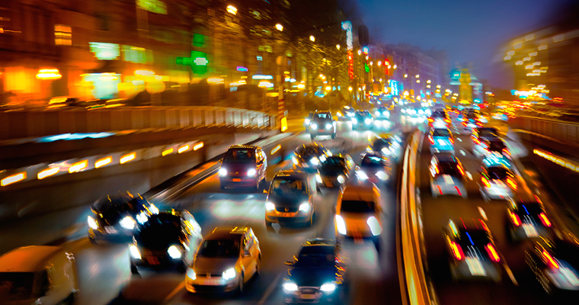
Traffic Violations
in New York
Jiayu 713551
Yifan 777275
Chaoxin 828707

Slide 2
Dataset: Traffic Violations
Dataset source: https://data.montgomerycountymd.gov/Public-Safety/Traffic-Violations/4mse-ku6q
DataMontgomery website
Contains data from all states in the U.S. from 2012 till March 2017 with a large range of contents such as date, car model, types of violations, geolocation etc.
Original data set size:
Rows: 1048576 Columns: 35

Slide 3
Problems that we faced
The dataset is huge and incomplete
There seems to be quite a few semantic errors
Not too many numeric values that can be used
Year and months written together, hard to use directly

Slide 4
Data processing to rescue
Deleted all states except for NY
Deleted attributes that we’re not interested in (e.g. agency, subagency)
Deleted rows with invalid data (such as year ‘9999’ and state ‘??’)
Added new columns that are helpful for data analysis (e.g. year, month, time period when traffic violations happens)
Eventually our new dataset has 17 columns and 3568 rows.

Slide 5
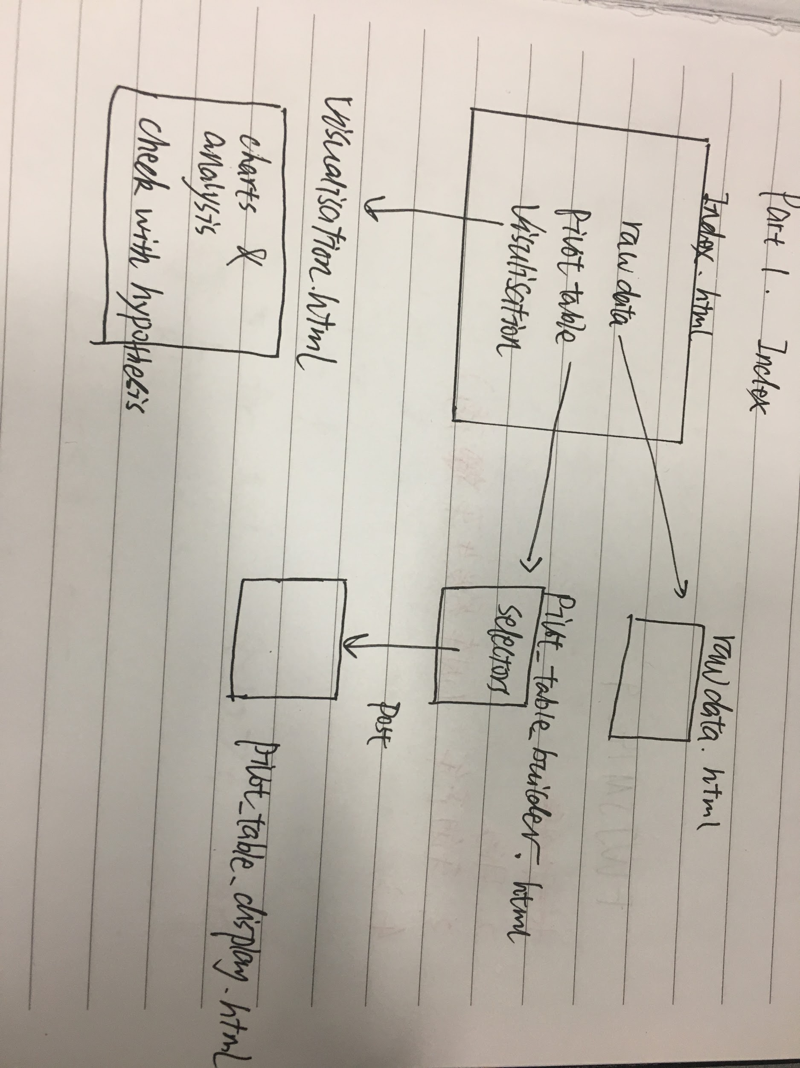
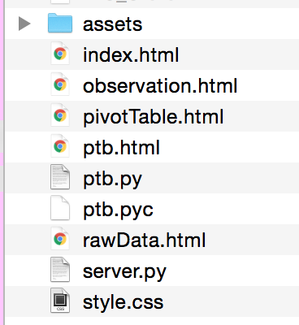
How we approached the project
We broke our website into 3 parts: raw data, pivot table, and our observation from the dataset.

Slide 6
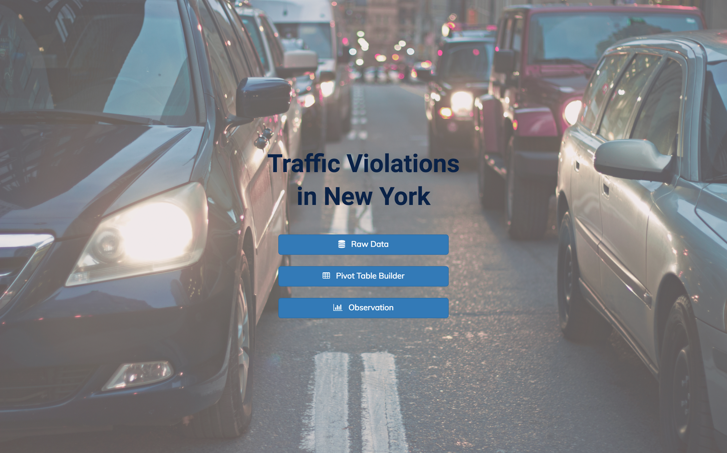

Slide 7
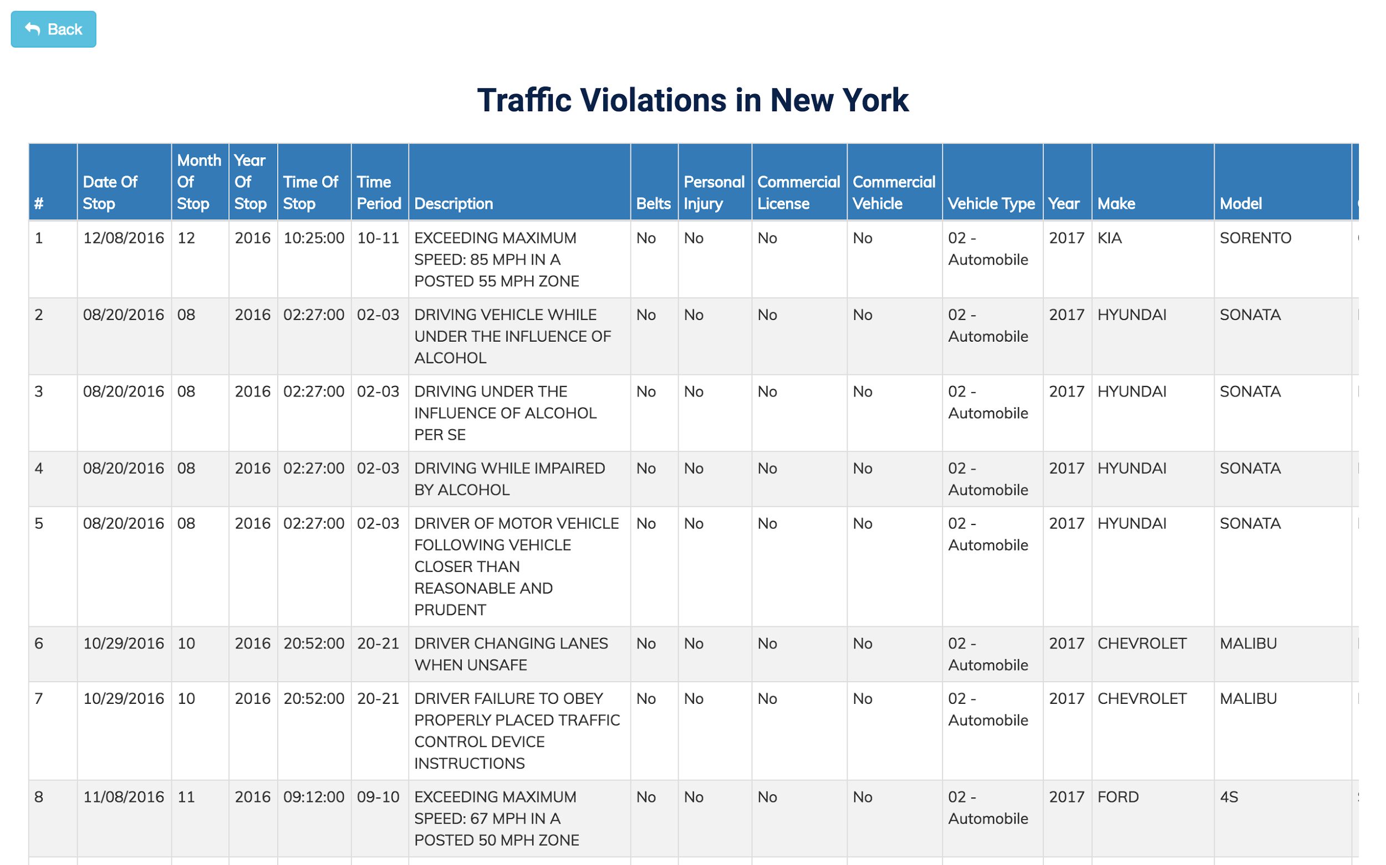

Slide 8
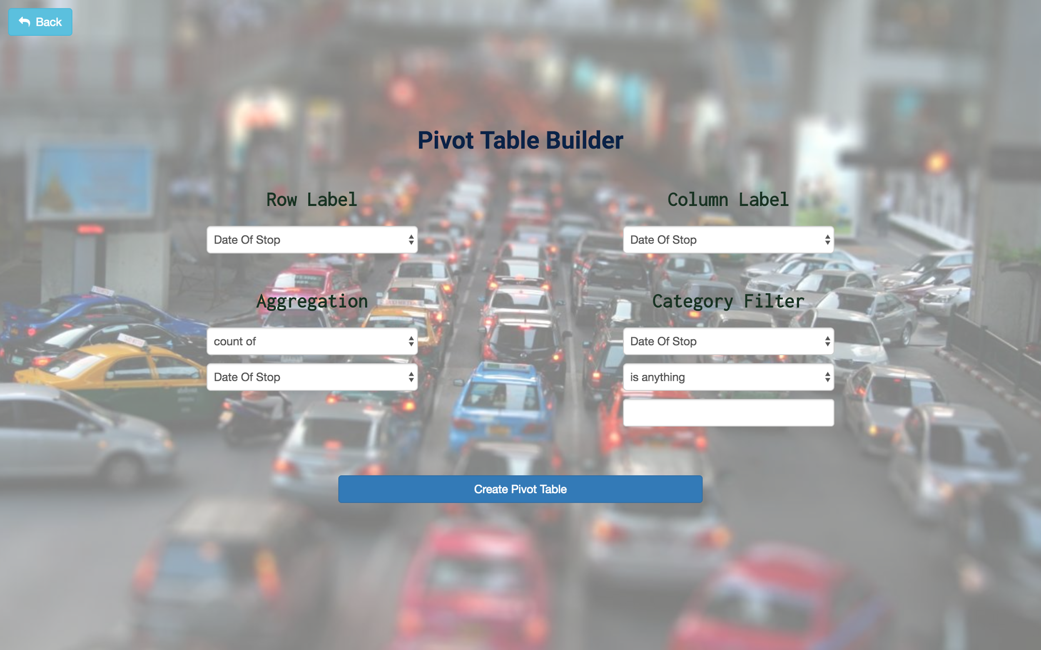

Slide 9
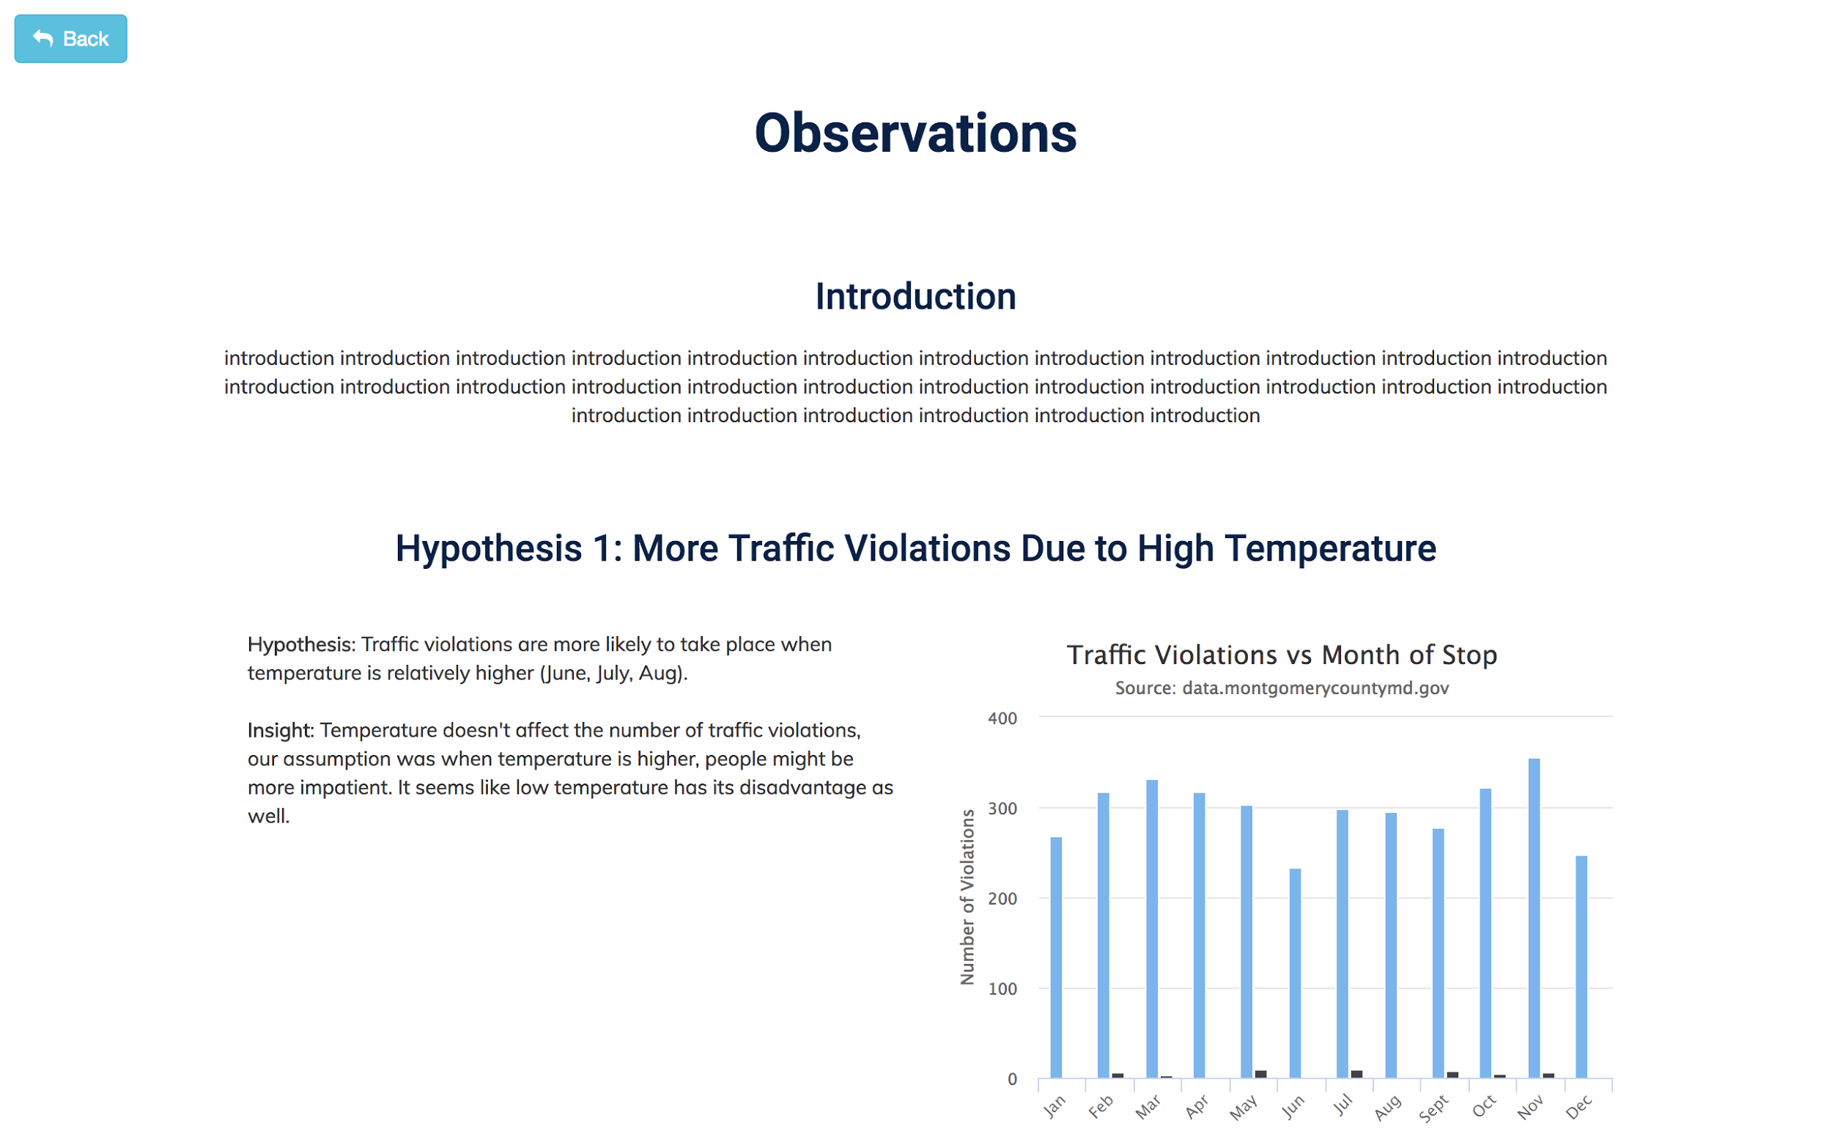

Slide 10
Structure and Tools
Server (in Python, using Flask)
Webpages (HTML, CSS, JavaScript)
External libraries:
Flask (as the router)
Panda to build pivot table
Jinja2 to connect HTML and server
Bootstrap to enrich css
Highchart

Slide 11
Hypothesis:
Traffic violations are more likely to take place when temperature is relatively higher (June, July, Aug)
Traffic violations tend to increase with the year goes by
‘Women are bad drivers’ stereotype is wrong!
Traffic violations at night are more likely to cause personal injuries
5. There is a correlation between traffic violations and unfastened seat belts

Slide 12
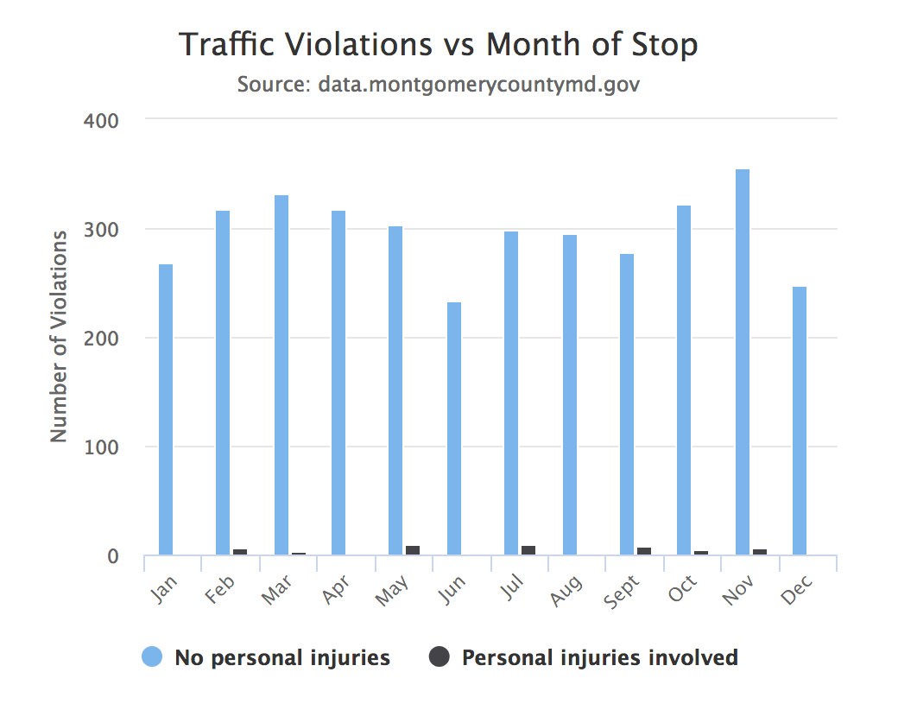
Insights
Temperature doesn’t affect the number of traffic violations, our assumption was when temperature is higher, people might be more impatient. It seems like low temperature has its disadvantage as well.

Slide 13
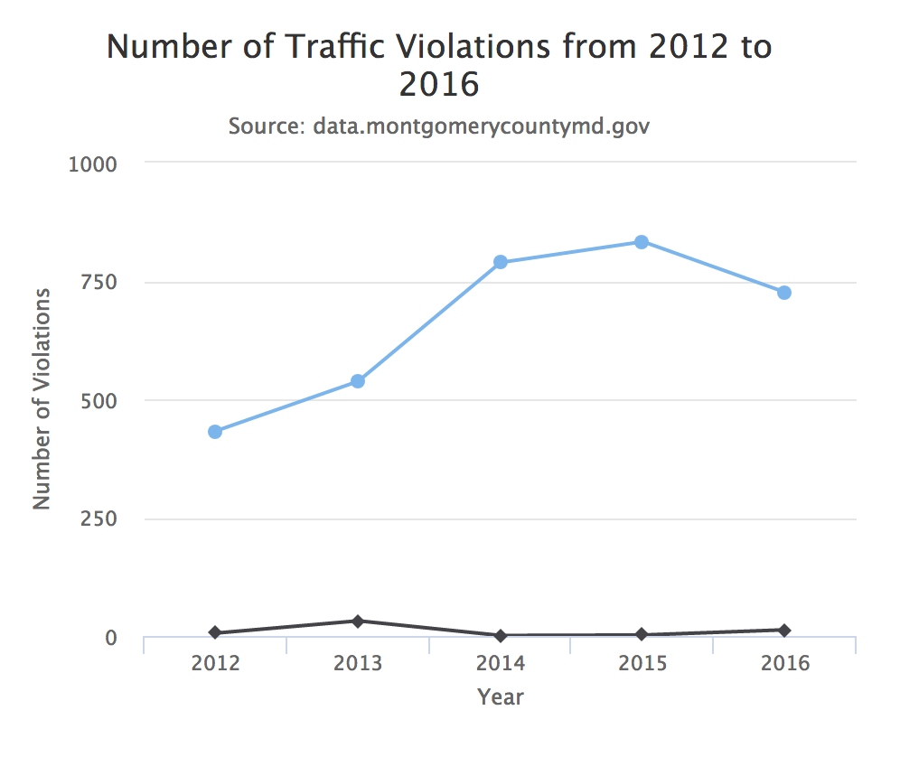
Insights
As time goes by, people seem to violate traffic rules more and more, it could be that many people start to drive, there are more new drivers who are not familiar with the road.

Slide 14

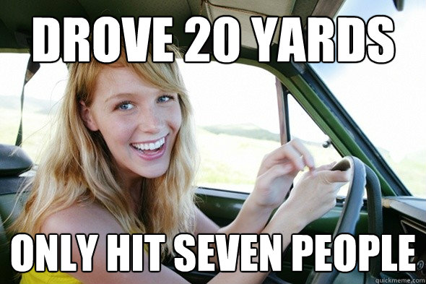
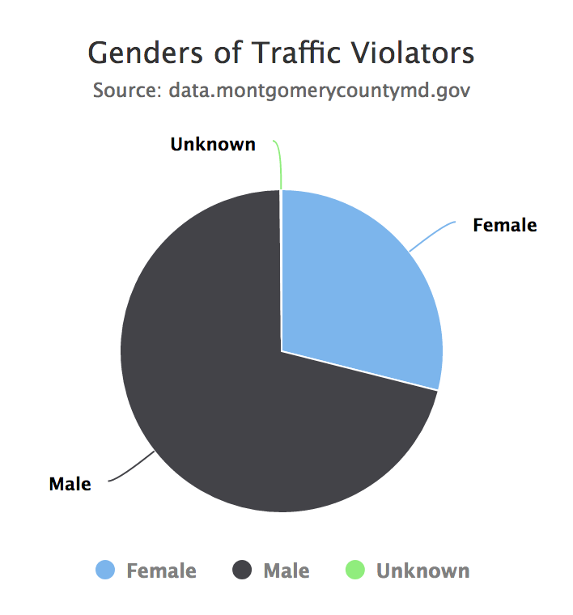
Insights
Women actually aren’t bad drivers, they are more conscious of what they’re doing than men sometimes!

Slide 15
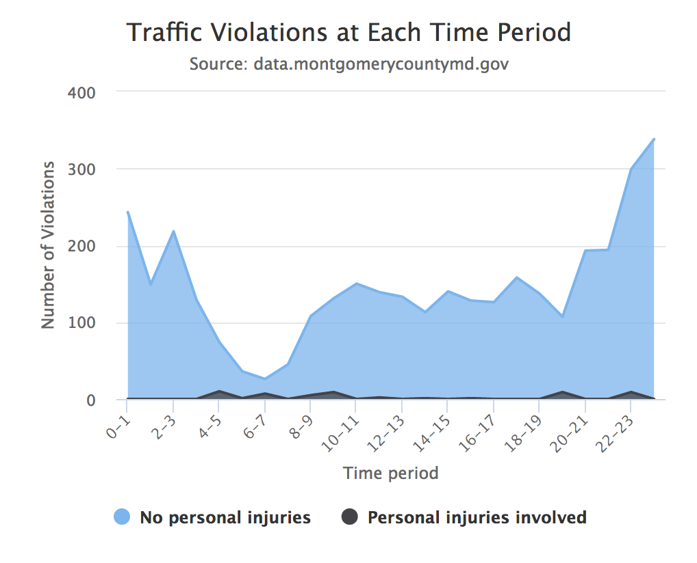
Insights
Bad lighting conditions could affect drivers sight, which leads to possible violations

Slide 16
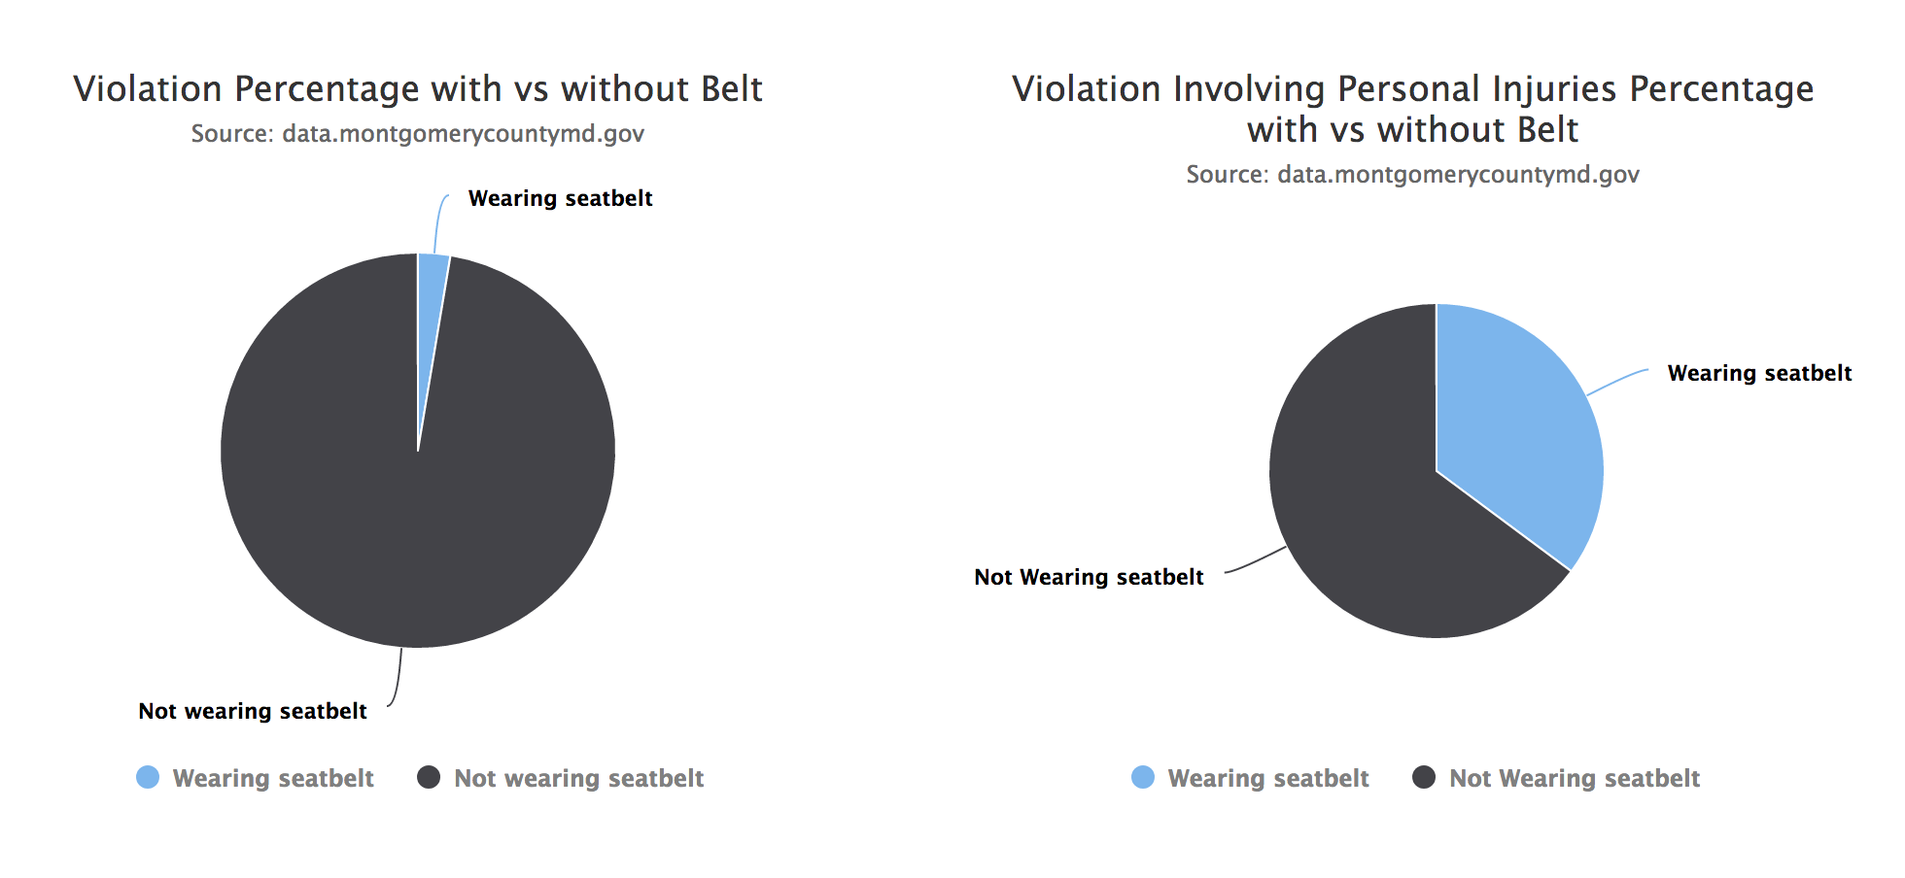
Insights
People who have a good driving habit, fasten their seat belt every time, and they’re more likely to respect the traffic rules

Slide 17

Thank you for listening!
Any questions?

